Slide 1
Internet of Things
Module 6, Lesson 1:
What is IoT

Slide 2
Topics
What is IoT?
Basic concepts of IoT
Infrastructure of IoT

Slide 3
Objectives
By the end of this lesson you should be able to:
Understand Internet of Thing
Understand IoT concept and Infrastructure

Slide 4
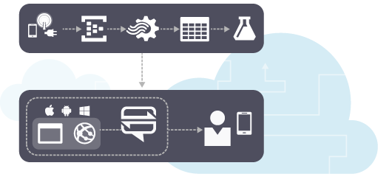
What is IoT?
Intelligent interactivity between human and things to exchange information & knowledge
A global infrastructure for the information society, enabling advanced services by interconnecting (physical and virtual) things¹.
1. http://www.itu.int/en/ITU-T/gsi/iot/Pages/default.aspx
Notes:
Notes:
A key concept of Internet of Things (IoT) is a Thing that does something useful to make Internet of Things happen.
References:
http://www.itu.int/en/ITU-T/gsi/iot/Pages/default.aspx
image source: http://iotinnovator.com/liebherr-domestic-appliances-collaborates-microsoft-build-new-smart-fridge-medicine/

Slide 5
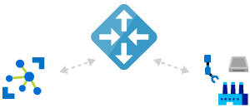
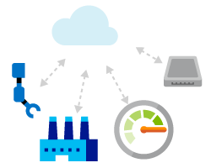
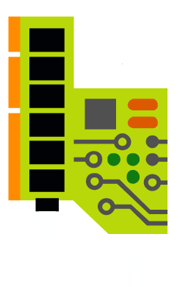
What is IoT? (Cont.)
Gateway
Event
Cloud computing
Sensor
Feedback
Thing
Notes:
Notes:
Establish bi-directional communication with millions of IoT devices.
A thing – does something useful.
A sensor – computes and communicates attached to the thing.
A gateway – collects data from the thing.
Cloud computing – analyzes data from sensor and providing feedback to the thing.
References:
Image source: https://1.bp.blogspot.com/-OpDDrfKKBV4/VrK5cPNS0RI/AAAAAAAALBk/1nEQTIRThY4/s1600/AzureIoTOnGA.PNG

Slide 6
What is IoT? (Cont.)
Key Words and Concept of Internet of Things
Concept | Description
Things | Sense, Compute, Communicate and Act
Network (Infrastructure) | Web of things, Internet of Everything, Cloud Networks
Data | Collect, analyze and act upon
Notes:
Things have to be useful and secure, authenticated and authorized.
They also have to be very low power.

Slide 7
Abstract Layer of IoT
Applications
Acting Subsystem
Storage / Management
Thinking Subsystem
Preprocessing / Reasoning
Raw data retrieval
Sensing Subsystem
Sensors
Notes:
Notes:
There are 3 subsystems in the Abstract layer of IoT. The 3 subsystems need to be connected to each other.
The distribution of each of these components depend on the application.
An application might have its own thinking & sensing subsystems.
Each subsystem:
must be complex and decoupled from each other, or tightly integrated into 1 service.
itself be a collection of distributed components
can interact with another subsystems without knowing the underlying details.

Slide 8
Sensor layer
3 different approaches to acquire contextual information
Direct sensor access
Middleware infrastructure
Context server
Notes:
Notes:
Direct sensor access
Used in devices with sensors locally built in.
The client software gathers the desired information directly from these Sensors.
It is not suited for distributed systems.
Middleware infrastructure
Introduces a layered architecture with the intention of hiding low-level sensing details.
Context server
Distributed approach extends the middleware based architecture by introducing an access managing remote component.
Gathering sensor data is moved to the context server to facilitate concurrent multiple access.

Slide 9
Raw Data Retrieval
Responsible for the retrieval of raw context data
Makes use of appropriate drivers for physical sensor and APIs for virtual and logical sensors.
The query functionality is often implemented in reusable software components.

Slide 10
Preprocessing & Reasoning
Responsible for reasoning and interpreting contextual information
The sensors queried in the underlying layer most often return technical data that are not appropriate to use by application.
This layer raises the results of layer two to a higher abstraction level. The transformations include extraction and quantization operations
Notes:
Notes:
The single information can be combined to high-level information, for more precious and accurate.
The problem of sensing conflicts might occur when using several data sources has to be solved in this layer.

Slide 11
Storage and Management
Organizes the gathered data and offers them to the client via a public interface
Clients may gain access in two ways:
Synchronous mode
Asynchronous mode
Notes:
Notes:
Synchronous mode : A Client sends a requesting message and pauses until it receives the server’s answer. (polling method)
Asynchronous mode : Each client subscribes to specific events it is interested in. (subscriptions method)

Slide 12
Application Layer
The client is realized in this layer.
The actual reaction on different events and context-instances is implemented in this layer
Sometimes information retrieval and application specific context management and reasoning is encapsulated in form of agents
Notes:
Notes:
The agents communicate with the context server and act as an additional layer between the preprocessing and the application layer.

Slide 13

Sensor
Sensors come in all kinds of flavors and can be combined
A Large variety of sensors :
Light, acceleration, location, temperature, biological signals, infrared, so on
Combination of multiple sensors
Notes:
Notes:
Sensors :
Provide a means to acquire data or information about the physical world
Used to determine actions
Combination of multiple sensors – more information to reason with and provide a more comprehensive view
Providing a bridge between the physical world and the virtual world of a computer system.

Slide 14
Sensor Types
Physical Sensors
Virtual Sensors
Logical Sensors
Sensor fusion
Notes:
Notes:
Physical sensors : only hardware sensor, capturing any physical data.
Virtual sensor : context data from software application or services. Ex) users activity by checking for mouse movement.
Logical sensor : understand the context using two or more in combination of the DB. Ex) Login information – check the user authorization.
Sensor fusion : combine data from multiple sensors, and related information from associated databases, to achieve improved accuracies and more specific inferences.

Slide 15
Sensor fusion
Techniques – detection, classification, identification of objects
Taking observation from a number of sensors
Solving equations to find values for variable
Mathematical equations relate sensor observations with known quantities and variables to be discovered

Slide 16
Classification of Sensors
Type of context | Use Sensors
Light | Photodiodes, color sensors, IR and UV-sensors etc.
Audio | Microphones
Motion, Acceleration | Mercury switches, angular sensor, accelerometers, motion detectors, magnetic fields
Location | GPS, Global system for mobile communications, Active badge system, etc
Physical attributes | Biosensors to measure skin resistance, blood pressure

Slide 17
Sensing (Context Acquisition)
Context Attributes
Attribute | Description
Location | an entity’s position
Identify | unique identifier
Activity | status
Time | timestamp

Slide 18
Sensing (RFID)
RFID (Radio Frequency Identification) tags or smart labels
Can be read from or written to, using RFID reader with energy from a radio frequency field.
RFID Tag
RFID Reader

Slide 19
Sensing (Location)
Location is widely used type of context in application.
Location Sensing | Description
GPS (global positioning system) | Use satellites, several meters accuracy
Mobile Phone Network | Suburb or town, 150~300 meter accuracy
WLAN | Triangulation with multiple access points, 1~2 meter accuracy
Bluetooth | short-range networking
Ubisense Sensor | for a tagged person, 15 cm accuracy

Slide 20
Sensor usage
Where to put sensor
Depends on the application and the type of sensor
Embedded in the environment as part of the room, car, or worn on people
Used to detect activities within an environment
Notes:
Notes:
For example, Smart Car
Wiper
Headlight switch
Cruise control
Drowsy driver warning
Car telematics
Parking & Driving aids

Slide 21
Infrastructure for IoT
Infrastructure
A well established, pervasive, reliable, and publicly accessible set of technologies that acts as a foundation for other systems.
A Middleware layer
Between sensors on one side and devices and applications on the other
Notes:
Notes:
The layered architecture subsystems can be abstracted into an infrastructure.
The middleware presents a uniform layer of abstraction, making it easier to update individual pieces independently of each other.

Slide 22
Infrastructure for IoT (Cont.)
Device
Apps
Device
Apps
Device
Apps
Context
Service
Sensor
Sensor
Sensor
Sensor
Sensor
Sensor

Slide 23
What makes IoT possible
Integrated circuits technologies
Miniature
High computing power
Low power
Wireless Technologies
Reaching everywhere
Low power
Networks
Ubiquitous and Omnipresent

Slide 24
Summary
In this lesson, you have learned:
Understand Internet of Things
Understand features and Infrastructure of IoT

